Slide 1
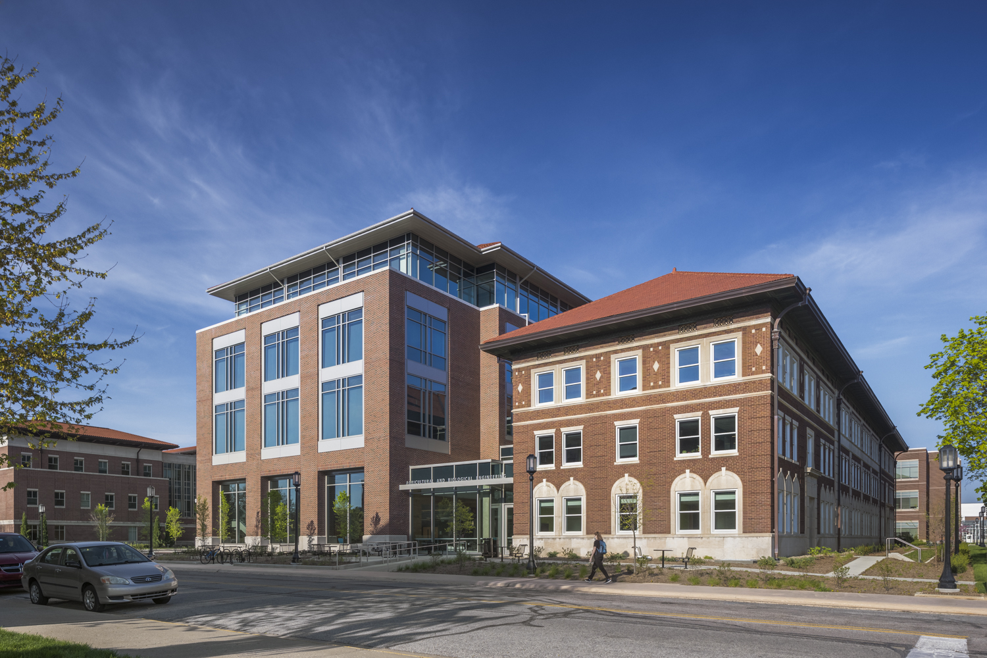

Welcome to ABE!

Slide 2
All Aboard ABE Overview
Meet the Agricultural and Biological Engineering (ABE) Undergraduate Academic Programs Staff
Best Practices
Review Degree Programs offered by ABE
Note upcoming events and important next steps

Slide 3
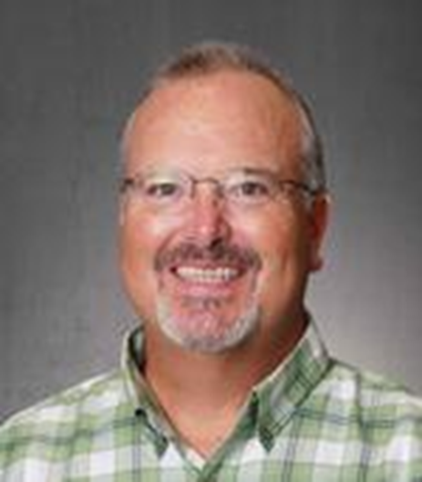
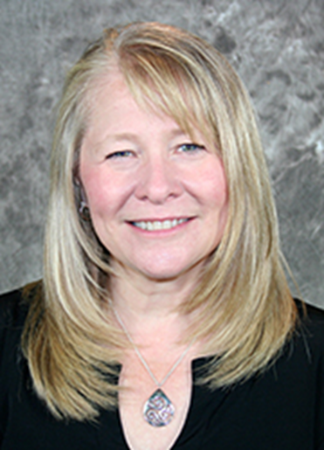

ABE Academic Programs Staff
Dan Taylor
Academic Coordinator/
Assistant to the Department Head
Duties:
ABE Ambassador Coordinator
Student Recruitment
Scholarships
Job Search Tips and Tricks
Brenda Schroeder
Director of Undergraduate Programs
Duties:
Internship/Co-Op Information & Approval
Study Abroad Information & Approval
Curriculum Support
Graduation Audits
Yvonne Hardebeck
Senior Undergraduate Program Coordinator
Duties:
Supports Undergraduate and Graduate programs
Publishes weekly newsletter (look for her email)

Slide 4
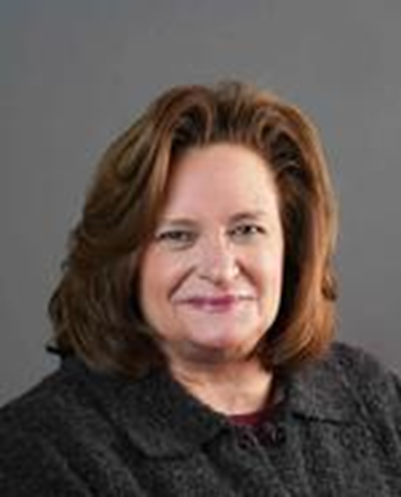

ABE Academic Advisors
Laurie Snyder
Senior Academic Advisor
Duties:
Advises Biological Engineering (BE) students
Coordinates Transition to Major Process
Coordinates recruitment sessions for First Year Engineering ( FYE)
Samantha Greulach
Academic Advisor
Duties:
Advises Pre-Agricutlural and Biological Engineering (PABE), Agricultural Systems Management (ASM, Agricultural Engineering (AE), Environmental and Natural Resources Engineering (ENRE) students
Coordinates All Aboard for ABE

Slide 5
Best Practices
Advisors Work Schedule M-F 8am – 5pm EST
Check your emails daily (recommended multiple times a day)
  Also best way to get ahold of your advisor!
Include your first/last name and PUID when emailing your advisor
If you’d like to include multiple people on an email, please CC the others on the email
  This allows everyone one the email to know who is involved and work together to solve the issue/concern
  Note it may take up to 2 days to get a response
Remember to Include all information in your email – the more detail the better
  Screenshots are always super helpful – especially if you’re getting an error message

Slide 6

ABE Undergraduate Degree Options
Bachelor of Science, BS – Agricultural System Management
Bachelor of Science in Agricultural Engineering, BSAGE
Agricultural Engineering OR Environmental and Natural Resources Engineering
Bachelor of Science in Biological Engineering, BSBE

Slide 7
ABE Degrees, Majors, and Concentrations
Agricultural Systems Management – Bachelor of Science, BS
Optional Concentrations in:
AgroSecurity
Data & Information Systems
Leadership & Management
Prepares you to:
Organize and manage environmentally stable, technology-driven business, focusing on industry or business projects aimed at delivering results.
Gain a deep understanding of how equipment and facilities are utilized for plant and animal operations, as well as their products
Apply biological sciences to optimize production and ensure the maintenance of top-quality products.
This program provides a strong foundation in:
In-depth technical knowledge for selecting and applying advanced technologies in food, feed, fiber, and fuel systems.
Problem-solving skills to address a wide range of business and technical challenged in a rapidly growing field.

Slide 8
ASM - Typical First Year Courses
Credits | Fall 1st Semester |  |  | Credits | Spring 1st Semester
.5 | AGR 10100 | Introduction to the College of Agriculture and Purdue University | General Chemistry I | 3 | ASM 10500 | Computing Technology With Applications | Computing Technology With Applications | General Chemistry II Or C Programming
.5 | AGR 11100 | Introduction to Agricultural and Biological Engineering Academic Programs | Transforming Ideas to Innovation I | 3 | CHM 11200 | General Chemistry II | General Chemistry II | Transforming Ideas to Innovation II
3 | ASM 10400 | Introduction to Agricultural Systems | Analytic Geometry and Calculus I | 3 | PHYS 21400 | The Nature of Physics | The Nature of Physics | Analytic Geometry and Calculus II
3 | CHM 11100 | General Chemistry I |  | 3 | AGEC 20300 or ECON 25100
3 | MA 16010 | Applied Calculus I |  | 3-4 | Written Communication Selective
3 | Human Cultures: Humanities Selective |  |  |  |  |  |  | Modern Mechanics
3 | Oral Communication Selective
16 |  |  |  | 15-16
AP/Dual credit may affect first-semester course selection. Your advisor will discuss options with you during your All Aboard registration appointment.

Slide 9
ABE Degrees, Majors, and Concentrations
Bachelor of Science in Agricultural Engineering, BSAGE – ABET Accredited
Major in Agricultural Engineering (Machine Systems)
Prepares you to:
Become a professional engineer in careers focusing on systems, process, and machines that are used to:
  Generate energy
  Utilize energy
  Produce Food
  Manage Water
Work in Agricultural Engineering as a leader in the application of new sensing vehicles subject to tough environments
This program provides a strong foundation in:
Mechanical design and system optimization
Hydraulics and fluid power systems
Instrumentation, controls system, and automation
Finite element analysis for structural modeling
Electronic, sensors, and smart technologies
Design and operation of machine and systems for agricultural and biological processes
Materials handling and logistics
Construction and mining equipment design
Forestry, lawn care, and grounds maintenance technologies
Food and fiber production, processing, and sustainability

Slide 10
ABE Degrees, Majors, and Concentrations
Bachelor of Science in Agricultural Engineering, BSAGE – ABET Accredited
Major in Environmental and Natural Resources Engineering
Prepares you to:
Apply fundamental engineering Principles alongside the latest technological advancements to address challenges in:
  Soil and plant environments
  Surfaces and groundwater quality
  Air quality management
  Animal environment
  Food safety and sustainability
This program provides a solid foundation in:
Mechanical design and system optimization
Hydraulics and fluid power systems
Instrumentation, control systems, and automation
Finite element analysis for structural integrity and design
Geotechnical engineering for soil and foundational analysis
Soil and water resource management and engineering
Water quality monitoring and ecological restoration practices
Forestry, lawn care, and ground maintenance technologies
Food and fiber production, processing, and sustainability techniques

Slide 11
ABE Degrees, Majors, and Concentrations
Bachelor of Science in Biological Engineering, BSAGE – ABET Accredited
Prepares you to:
Design and analyze biological systems to create innovative, practical solutions.
Equip graduate for successful careers in industries such as:
  Food production and processing
  Pharmaceutical and biotechnology
  Bioprocessing and biomedical engineering
Prepare for further education opportunities, including graduate school or medical school.
The program provides a comprehensive foundation in:
Mechanical design and system optimization
Statistical modeling and data analysis
Microbiology and its applications
Advanced modeling and computations tools
Biochemical laboratory techniques and methodologies
Physical chemistry principles and their applications
Sensors, process control, and automation system
Biochemistry and it’s role in biological processes
Optional Concentrations in:
Bio Environmental Engineering
Cellular and Biomolecular Engineering
Food & Biological Engineering
Pharmaceutical Process Engineering

Slide 12
ABE Degrees, Majors, and Concentrations
Pre- Agriculture and Biological Engineering (Pre-ABE)
Difference between Pre-ABE and First – Year Engineering:
Pre-ABE Offers an alternative pathway to First-Year Engineering, with the same required courses.
Thanks to a strong connection with Agriculture, we provide the unique opportunity for engineering students to join our program as freshman.
Upon successfully completing the one-year Pre-ABE curriculum students can seamlessly transition into their desired professional program within Agricultural and Biological Engineering.
Perks of Pre-ABE:
Meet regularly with an Academic Advisor from the ABE department for personalized Guidance
Receive invitations to exclusive ABE events, providing opportunities to connect with faculty and fellow ABE Students.
Enjoy a smooth and streamlined transition into your professional program.

Slide 13
Pre-ABE - Typical First Year Courses
Credits | Fall 1st Semester |  |  | Credits | Spring 1st Semester
4 | CHM 11510 & CHM 1520 | General Chemistry I (CHM 11510) General Chemistry I – Laboratory (CHM 11520) | General Chemistry I | 4 | CHM 11610 & CHM 11620 or CS 15900 or CS 17700 | General Chemistry II Or C Programming Or Programming with Multimedia Objects (Preferred) | General Chemistry II Or C Programming
2 | ENGR 13100 | Transforming Ideas to Innovation I | Transforming Ideas to Innovation I | 2 | ENGR 13200 | Transforming Ideas to Innovation II | Transforming Ideas to Innovation II
4 | MA 16500 | Analytic Geometry and Calculus I | Analytic Geometry and Calculus I | 4 | MA 16600 | Analytic Geometry and Calculus II | Analytic Geometry and Calculus II
3 | Human Cultures: Humanities Selective |  |  | 4 | PHYS 17200 | Modern Mechanics | Modern Mechanics
3-4 | Written Communication Selective |  |  | 3 | Oral Communication Selective
17-18 |  |  |  | 16-17
AP/Dual credit may affect first-semester course selection. Your advisor will discuss options with you during your All Aboard registration appointment.

Slide 14
All Aboard Registration Process
ABE Advisors will be conducting Registration Appointments between May 19th and July 1st
Watch your Purdue email for an invitation to schedule your registration appointment.
Appointments will be held online via ZOOM*
  Have access to a computer or laptop which will make the registration process run smoother.
Prepare for your Advising Meeting
  We want to get to know YOU – be prepared to tell us a little about yourself (hobbies, interests, career goals, etc)!
  Keep your list of earned/expected AP and Dual credits handy so we can discuss how/if you want to apply them to your degree. (Be sure you entered these courses on your Student Information Form!)
    Send all transcripts to Purdue as soon as possible so those can get applied to your student record.
  Prepare a list of questions for your advisor – questions can be about academics, transitioning to Purdue from high school, campus resources and opportunities, etc – don’t hesitate to ask – we’re here to help!
*If you do not have access to a computer, a phone appointment is an option, please indicate your need for an alternative meeting mode when you register for your appointment.

Slide 15

Next Steps following Registration
Enjoy the remainder of your time before classes start!
Complete Purdue 102 and all items on your New Student Task List.
View your finalized Fall 2025 schedule. Schedules will be available July 24th by 5 p.m.
  Schedule modification may be made beginning July 28th, but only after consultation with your advisor!
Confirm your enrollment and meet financial obligations.
Register for and attend an Orientation Program!
  Registration is open now through July 31, 2025 for Boiler Cold Rush!
  Boiler Cold Rush will take place August 17-19, 2025.
Classes Begin – Monday, August 25, 2025
Be sure to check your Purdue email regularly throughout the summer!

Slide 16
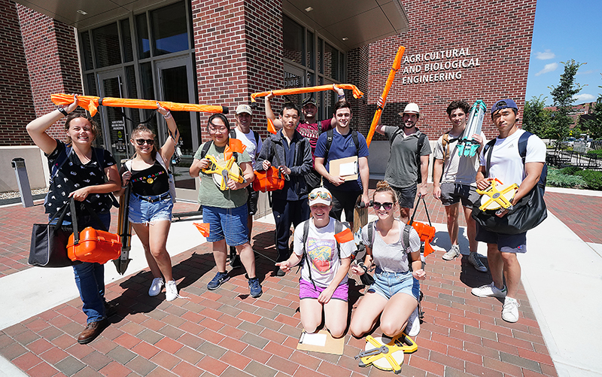
WELCOME TO ABE
We can’t wait
for you to join us this Fall!
BOILER UP!

